Slide 1
Unit II Modeling and Evaluation
S.Hemalatha
Assistant professor(Sr.G)
Dept of CA
Kongu Engineering College

Slide 2
Modeling
The modeling means training a machine learning algorithm to predict the labels from the features, tuning it for the business need, and validating it on holdout data.
Machine tries to emulate human learning by applying mathematical and statistical formulations.
the basic learning process, can be divided into three parts:
1. Data Input
2. Abstraction(Learning Process)
3. Generalization

Slide 3
Model
In learning process, abstraction is a significant step as it represents raw input data in a summarized and structured format, such that a meaningful insight is obtained from the data.
structured representation of raw input data to the meaningful pattern is called a model.
Algorithm and model
An “algorithm” in machine learning is a procedure that is run on data to create a machine learning “model.”
Machine learning algorithms perform “pattern recognition.” Algorithms “learn” from data, or are “fit” on a dataset.
The model might have different forms.: It might be a mathematical equation, or a graph or tree structure, or a computational block, etc.
a model is comprised of both data and a procedure for how to use the data to make a prediction on new data. Machine Learning Model == Model Data + Prediction Algorithm
Machine learning models are output by algorithms and are comprised of model data and a prediction algorithm.

Slide 4
Algorithm and model –difference (simple understanding)
An algorithm is a mathematical technique.
An algorithm is derived by statisticians and mathematicians for a particular task i.e. in our case prediction.
Only when they were implemented in the form of a code in a computer, the algorithms’ utility increased to a very great extent since the computers can handle high computation very easily.
An example. y=w0+w1x
Similarly every algorithm has some mathematical form underneath it, which when implemented in a machine developed to form a machine learning algorithm.
defining a model.
In the above equation, you cannot find y if you don’t know w0 and w1.
let’s take the 2 points be (x1,y1)=(1,1) and (x2,y2)=(2,2),Now by slope-point form ,can find w1 for which the formula is
w1=y1−y2/x1−x2.
So, w1=−1 and w0=0, By all this calculation, we have an equation,
y=0+(−1)x - This is a model.
So we can now say that a model is an equation which is formed by finding out the parameters (w0,w1) in the equation of the algorithm. And you create a model using some data, in this case, the two points which we helped us calculate w0,w1. This is called training a model.
Now we can find any value of y given a new value of x. This is how prediction takes place using algorithms.

Slide 5
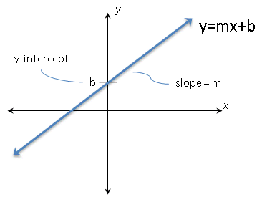

Slide 6
when the problem is related to prediction and the target field is numeric and continuous, the regression model is assigned.
The process of assigning a model, and fitting a specific model to a data set is called model training.
Bias:
If the outcome is systematically incorrect, the learning is said to have a bias.
While making predictions, a difference occurs between prediction values made by the model and actual values/expected values, and this difference is known as bias errors or Errors due to bias.
https://www.javatpoint.com/bias-and-variance-in-machine-learning

Slide 7
Selecting a Model
Input variables:
Also called predictors, attributes, features, independent variables, or simply variables.
Input variables can be denoted by X,
while individual input variables are represented as X1, X2, X3, …, Xn
Output variables
Also called response or dependent variable
output variable by symbol Y
The relationship between X and Y is represented in the general form
Y = f (X) + e
where ‘f ’ is the target function and ‘e’ is a random error term.
A target function, in machine learning, is a method for solving a problem that an AI algorithm parses its training data to find

Slide 8
Other functions
Cost Function (or Error function)
A function that measures the performance of a Machine Learning model for given data.
helps to measure the extent to which the model is going wrong in estimating the relationship between X and Y.
It calculates the difference between the expected value and predicted value and represents it as a single real number.(Error = actual value – predicted value)
Loss function
It's a method of evaluating how well your algorithm models your dataset.
Similar to cost function but the only difference is
loss function is usually a function defined on a data point, while cost function is for the entire training data set.
Objective Fucntion:
Goal of ML is minimizing Objective fucntion – so that reduce the loss, so accuracy improved
However, we need to have a way to evaluate the quality or optimality of a solution. This is done using objective function(score function).
Objective function takes in data and model (along with parameters) as input and returns a value.
Target is to find values of model parameter to maximize or minimize the return value. When the objective is to minimize the value, it becomes synonymous to cost function.

Slide 9
Predicted Sales Price (In lakh) | Actual Sales Price(In lakh) | Deviation (Loss)
Bangalore: 45 Pune: 35 Chennai: 40 |  | 0 (All predictions are correct)
Bangalore: 40 Pune: 35 Chennai: 38 | Bangalore: 45 Pune: 35 Chennai: 40 | 5 lakh for Bangalore, 2 lakh for Chennai
Bangalore: 43 Pune: 30 Chennai: 45 |  | 2 lakh for Bangalore, 5 lakh for, Pune2 lakh for Chennai,
A loss function/error function is for a single training example/input.
A cost function, is the average loss over the entire training dataset

Slide 10
Three broad categories of machine learning approaches
1. Supervised
1. Classification
2. Regression
2. Unsupervised
1. Clustering
2. Association analysis
3. Reinforcement
Multiple factors play a role when we try to select the model for solving a machine learning problem.
The most important factors are
the kind of problem we want to solve using machine learning and
The nature of the underlying data.

Slide 11
Model selection in a structured way
models for supervised learning, which primarily focus on solving predictive problems and
models for unsupervised learning, which solve descriptive problems

Slide 12
Predictive models
To predict certain value using the values in an input data set.
The learning model attempts to establish a relation between the target feature, i.e.the feature being predicted, and the predictor features.
To predict the value of a category or class to which a data instance belongs to.
Examples:
1. Predicting win/loss in a cricket match
2. Predicting whether a transaction is fraud
3. Predicting whether a customer may move to another product
Classification models:
The models which are used for prediction of target features of categorical value
target feature - class label
Categories to which classes are divided into are called levels.
Classification models:
k-Nearest Neighbor (kNN), Naïve Bayes, and Decision Tree.

Slide 13
Predictive models
To predict numerical values of the target feature based on the predictor features.
Examples:
Prediction of rainfall amount in the coming monsoon
Prediction of potential flu patients and demand for flu shots next winter
Prediction of revenue growth in the succeeding year
Regression models:
The models which are used for prediction of the numerical value of the target feature of a data instance.
Examples:
Linear Regression
Logistic Regression
Support Vector Machines
Neural Network (for both classification and regression)

Slide 14
Descriptive models
to describe a data set or gain insight from a data set. (Based on the value of all features, interesting patterns or insights are derived about the data set.)
No target feature or single feature of interest in case of unsupervised learning.
Descriptive models which group together similar data instances, clustering models
Examples:
Customer grouping or segmentation based on social, demographic, ethnic, etc. factors
Grouping of music based on different aspects like genre, language, time_period, etc.
Grouping of commodities in an inventory
Descriptive models related to pattern discovery is used for market basket analysis of transactional data
Models:
K-means

Slide 15
TRAINING A MODEL (FOR SUPERVISED LEARNING)
1.Holdout method:
Method of partitioning the input data into two parts – training and test data
which is by holding back a part of the input data for validating the trained model
Subset of the input data is used as the test data for evaluating the performance of a trained model.
In general 70%–80% of the input data (which is obviously labelled) - or model training
The remaining 20%–30% - as test data for validation of the performance of the model.
Once the model is trained using the training data, the labels of the test data are predicted using the model’s target function.
Then the predicted value is compared with the actual value of the label
The performance of the model is in general measured by the accuracy of prediction of the label value.
The difference between training data vs. test data is clear: one trains a model, the other confirms it works correctly

Slide 16
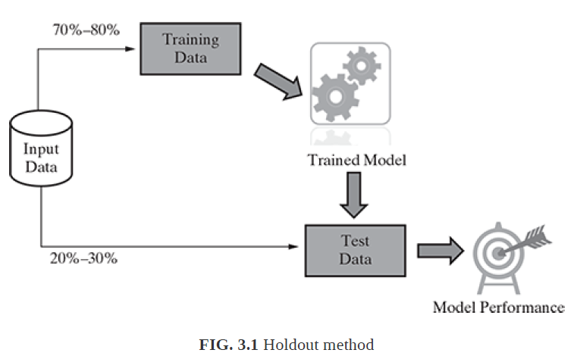

Slide 17
Holdout method
In certain cases, the input data is partitioned into three portions – a training and a test data, and a third validation data.
Validation data:
During training, validation data infuses new data into the model that it hasn’t evaluated before.
Validation data provides the first test against unseen data, allowing data scientists to evaluate how well the model makes predictions based on the new data.
Not all data scientists use validation data, but it can provide some helpful information to optimize hyperparameters, which influence how the model assesses data.
This is under training process
Test data:
After the model is built, testing data once again validates that it can make accurate predictions.
If training and validation data include labels to monitor performance metrics of the model, the testing data should be unlabeled. Test data provides a final, real-world check of an unseen dataset to confirm that the ML algorithm was trained effectively.

Slide 18
Problem in this method:
the division of data of different classes into the training and test data may not be proportionate(not in same ratio/not constant).
This situation is worse if the overall percentage of data related to certain classes is much less compared to other classes.
Bex of random sampling is employed for test data selection.
Solution:
by applying stratified random sampling in place of sampling.
the whole data is broken into several homogenous groups or strata and a random sample is selected from each such stratum.
This ensures that the generated random partitions have equal proportions of each class.
Simple random samples and stratified random samples are both statistical measurement tools.
A simple random sample is used to represent the entire data population.
A stratified random sample divides the population into smaller groups, or strata, based on shared characteristics.

Slide 19
TRAINING A MODEL (FOR SUPERVISED LEARNING)
2. K-fold Cross-validation method:
Challenge faced in stratified random sampling approach:
the smaller data sets - to divide the data of some of the classes proportionally amongst training and test data sets.
A special variant of holdout method, called repeated holdout, is sometimes employed to ensure the randomness of the composed data sets.
In repeated holdout, several random holdouts are used to measure the model performance.
In the end, the average of all performances is taken.
This process of repeated holdout is the basis of k-fold crossvalidation technique.
In k-fold cross-validation, the data set is divided into k-completely distinct or non-overlapping random partitions called folds.

Slide 20
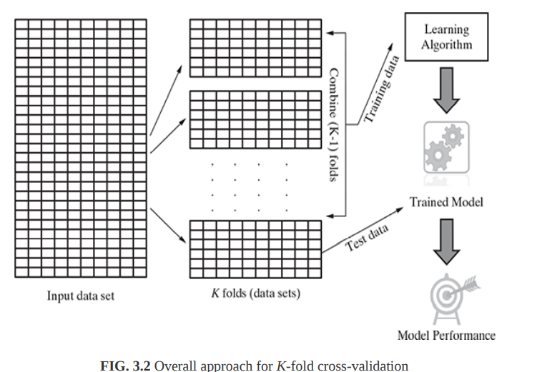

Slide 21
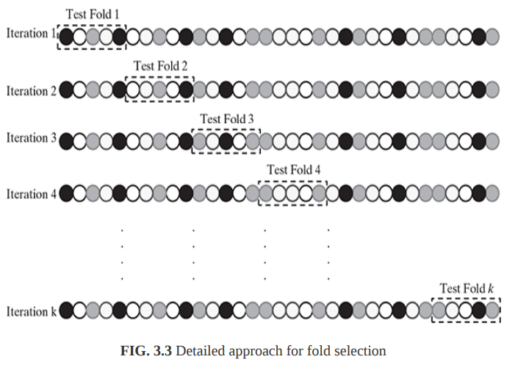

Slide 22
There are two approaches which are extremely popular:
1. 10-fold cross-validation (10-fold CV)
2. Leave-one-out cross-validation (LOOCV)
10-fold cross-validation (10-fold CV):
for each of the 10-folds, each comprising of approximately 10% of the data,
one of the folds - as the test data for validating model.
remaining 9 folds (or 90% of the data) – as training data.
This is repeated 10 times, once for each of the 10 folds being used as the test data and the remaining folds as the training data.
The average performance across all folds is being reported.

Slide 23
Leave-one-out cross-validation (LOOCV):
It is an extreme case of k-fold cross-validation using one record or data instance at a time as a test data.
This is done to maximize the count of data used to train the model.
It is obvious that the number of iterations for which it has to be run is equal to the total number of data in the input data set.
Hence, obviously, it is computationally very expensive and not used much in practice

Slide 24
3.Bootstrap sampling:
It uses the technique of Simple Random Sampling with Replacement (SRSWR), which is a well-known technique in sampling theory for drawing random samples.
Unlike this approach adopted in case of k-fold cross- validation, bootstrapping randomly picks data instances from the input data set, with the possibility of the same data instance to be picked multiple times.
This essentially means that from the input data set having ‘n’ data instances, bootstrapping can create one or more training data sets having ‘n’ data instances, some of the data instances being repeated multiple times.
This technique is particularly useful in case of input data sets of small size, i.e. having very less number of data instances.

Slide 25
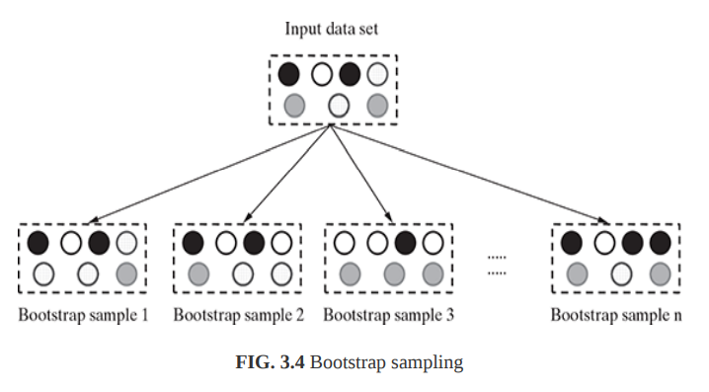

Slide 26
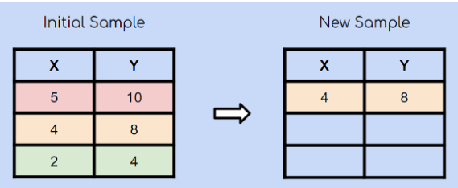
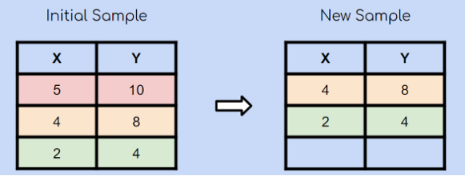
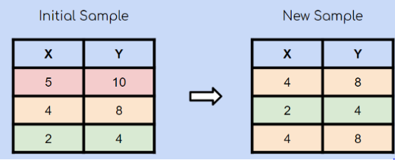

Slide 27
Eager and Lazy learner
Eager learner:
When it receive data set it starts classifying (learning)
Then it does not wait for test data to learn
So it takes long time learning and less time classifying data.
It follows the typical steps of machine learning, i.e. abstraction and generalization and comes up with a trained model at the end of the learning phase.
Hence, when the test data comes in for classification, the eager learner is ready with the model and doesn’t need to refer back to the training data.
algorithms which adopt eager learning approach include Decision Tree, Support Vector Machine, Neural Network, etc.

Slide 28
Lazy learner:
Just store Data set without learning from it and Start classifying data when it receive Test data.
Lazy learners simply store the training data and wait until a testing data appear. When it does, classification is conducted based on the most related data in the stored training data.
So it takes less time learning and more time classifying data
completely skips the abstraction and generalization processes.
lazy learning uses training data as-is, it is also known as rote learning (i.e. memorization technique based on repetition without understanding of the reasoning).
Due to its heavy dependency on the given training data instance, it is also known as instance learning. They are also called non-parametric learning. (number of parameters grows with the size of the training data)
as for each tuple of test data, a comparison-based assignment of label happens.
k-nearest neighbor.

Slide 29


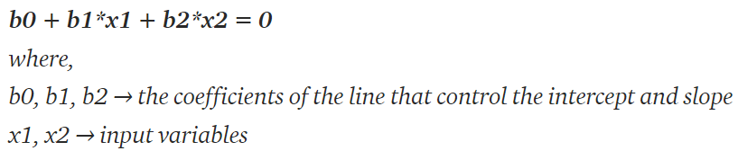
Notes:
Parametric learning models have finite number of parameters.
In case of non-parametric models, quite contradicting to its name, the number of parameters is potentially infinite. The parameters are adjustable and can change.
Models such as Linear Regression and Support Vector Machine, since the coefficients form the learning parameters, they are fixed in size. Hence, these models are clubbed as parametric. Or linear machine learning algorithms
On the other hand, in case of models such as k-Nearest Neighbor (kNN) and decision tree, number of parameters grows with the size of the training data. Hence, they are considered as non-parametric learning models.
linear regression line:

Slide 30
MODEL REPRESENTATION AND INTERPRETABILITY
interpretability is the degree to which a model can be understood in human terms
the goal of supervised machine learning is to learn or derive a target function which can best determine the target variable from the set of input variables.
learning the target function from the training data is the extent of generalization
because the input data is just a limited, specific view and the new, unknown data in the test data set may be differing quite a bit from the training data.
Fitness of a target function approximated by a learning algorithm determines how correctly it is able to classify a set of data.
Two main problems that occur in machine learning and degrade the performance of the machine learning models:
Underfitting
Overfitting

Slide 31
Underfitting:
simply means that our model or the algorithm does not fit the data well enough.(where a data model is unable to capture the relationship between the input and output variables accurately)
If the target function is kept too simple, it may not be able to capture the essential nuances(eg difference b/w light lime green and lime green) and represent the underlying data well.
Many times underfitting happens due to unavailability of sufficient training data.
Underfitting results in both poor performance with training data as well as poor generalization to test data.
Underfitting can be avoided by
using more training data
increase the duration of training to get better results
3. reducing features by effective feature selection
High bias and low variance

Slide 32
Overfitting: A statistical model is said to be overfitted when we train it with a lot of data .
When a model gets trained with so much data, it starts learning from the noise and inaccurate data entries in our data set. Then the model does not categorize the data correctly, because of too many details and noise.
Overfitting results in good performance with training data set, but poor generalization and hence poor performance with test data set.
Overfitting can be avoided by
1. using re-sampling techniques like k-fold cross validation
2. hold back of a validation data set
3. remove the nodes which have little or no predictive power for the given machine learning problem
Overfitting – High variance and low bias

Slide 33
Good Fit in a Statistical Model:
Ideally, the case when the model makes the predictions with 0 error, is said to have a good fit on the data. This situation is achievable at a spot between overfitting and underfitting.
will stop training at a point just before where the error starts increasing.
Both underfitting and overfitting result in poor classification quality which is reflected by low classification accuracy

Slide 34
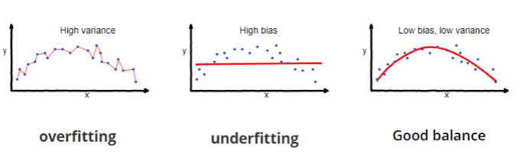
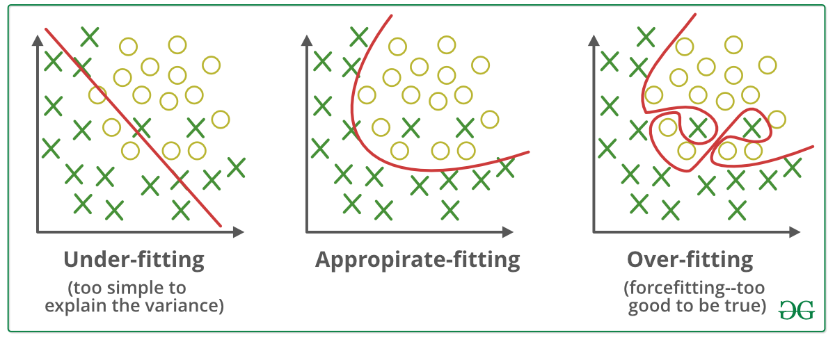

Slide 35
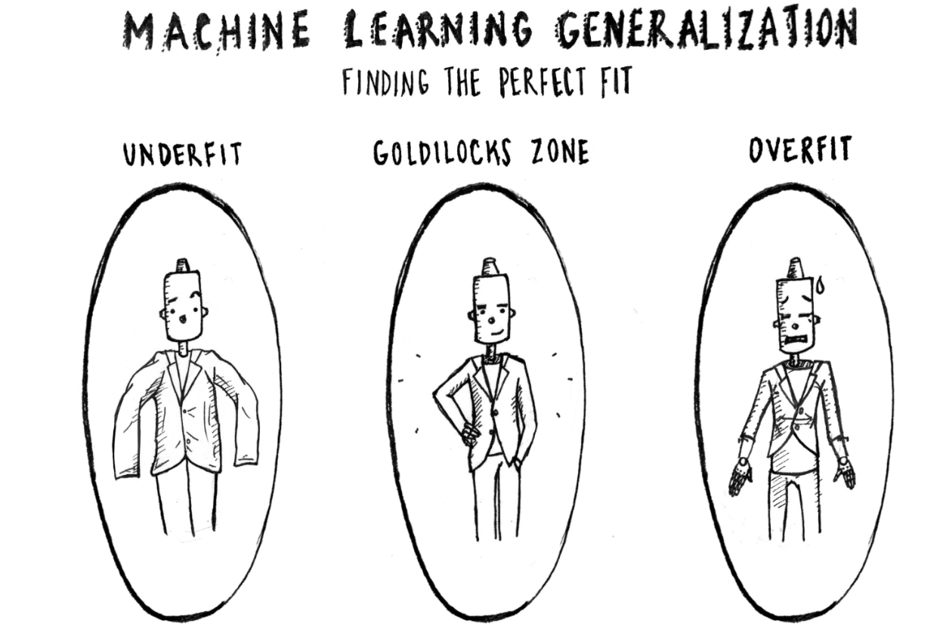
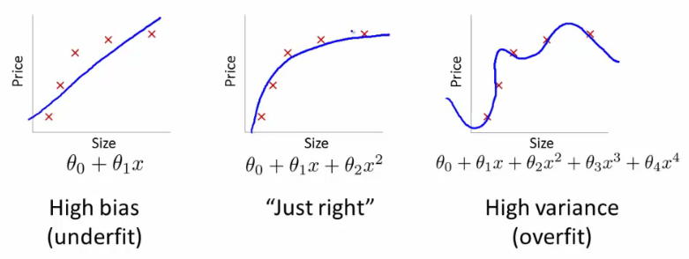

Slide 36
In supervised learning, the class value assigned by the learning model built based on the training data may differ from the actual class value.
This error in learning can be of two types –
errors due to ‘bias’ and
error due to ‘variance’
Bias is considered a systematic error that occurs in the machine learning model itself due to incorrect assumptions in the ML process. Technically, we can define bias as the error between average model prediction and the ground truth.
Bias: Assumptions made by a model to make a function easier to learn.
Variance: If you train your data on training data and obtain a very low error, upon changing the data and then training the same previous model you experience a high error, this is variance.

Slide 37
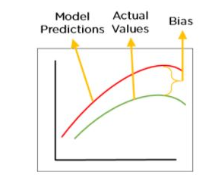

Slide 38
Errors due to bias arise from simplifying assumptions made by the model to make the target function less complex or easier to learn.
Parametric models generally have high bias making them easier to understand/interpret and faster to learn.
These algorithms have a poor performance on data sets, which are complex in nature and do not align with the simplifying assumptions made by the algorithm
Underfitting results in high bias.

Slide 39
Errors due to variance occur from difference in training data sets used to train the model.
Variance is the variability of model prediction for a given data point or a value which tells us spread of our data.
Model with high variance pays a lot of attention to training data and does not generalize on the data which it hasn’t seen before.
As a result, such models perform very well on training data but has high error rates on test data.
Ideally the difference in the data sets should not be significant and the model trained using different training data sets should not be too different.
However, in case of overfitting, since the model closely matches the training data, even a small difference in training data gets magnified in the model.

Slide 40
So, the problems in training a model can either happen because either
(a) the model is too simple and hence fails to interpret the data grossly
(b) the model is extremely complex and magnifies even small differences in the training data.
As is quite understandable:
Increasing the bias will decrease the variance, and
Increasing the variance will decrease the bias
On one hand, parametric algorithms are generally seen to demonstrate high bias but low variance.
On the other hand, non-parametric algorithms demonstrate low bias and high variance.

Slide 41
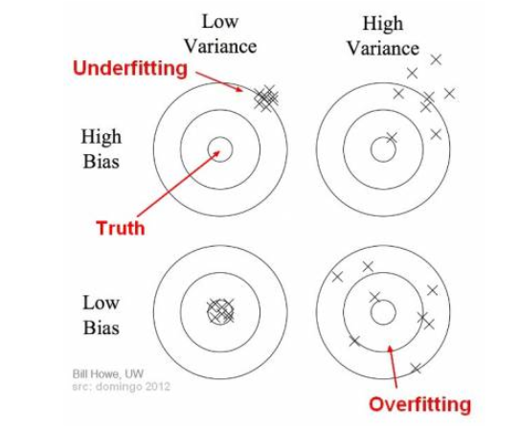
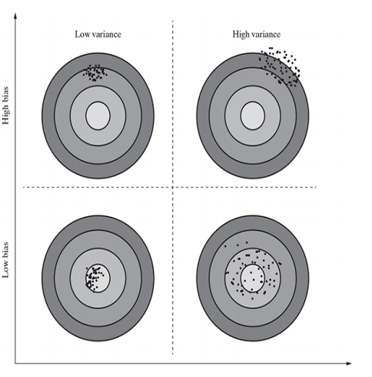
Bias-variance trade-off
Increasing the bias will decrease the variance
Increasing the variance will decrease the bias

Slide 42
the best solution is to have a model with low bias as well as low variance.
However, that may not be possible in reality.
Hence, the goal of supervised machine learning is to achieve a balance between bias and variance.
The learning algorithm chosen and the user parameters which can be configured helps in striking a tradeoff between bias and variance.

Slide 43
EVALUATING PERFORMANCE OF A MODEL
Supervised learning – classification:
The responsibility of the classification model is to assign class label to the target feature based on the value of the predictor features.
To evaluate the performance of the model, the number of correct classifications or predictions made by the model has to be recorded.
A classification is said to be correct if, say for example, it has been predicted by the model that the team will win and it has actually won.
Based on the number of correct and incorrect classifications or predictions made by a model, the accuracy of the model is calculated.
99% accuracy in case of a sports win predictor model may be reasonably good but the same number may not be acceptable as a good threshold when the learning problem deals with predicting a critical illness. In this case, even the 1% incorrect prediction may lead to loss of many lives.
we need to look more closely at the model accuracy and also at the same time look at other measures of performance of a model like sensitivity, specificity, precision, etc

Slide 44
Example:
There are four possibilities with regards to the cricket match win/loss prediction:
1. the model predicted win and the team won - True Positive (TP) case
2. the model predicted win and the team lost - False Positive (FP) case
3. the model predicted loss and the team won -False Negative (FN) case
4. the model predicted loss and the team lost - True Negative(TN) cases
obvious class of interest is ‘win’.
The first case, i.e. the model predicted win and the team won is a case where the model has correctly classified data instances as the class of interest. These cases are referred as True Positive (TP) cases.

Slide 45
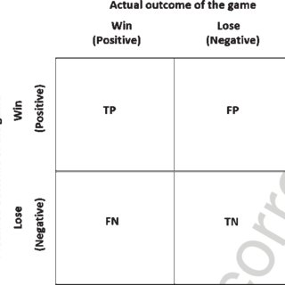

Slide 46

For any classification model, model accuracy is given by total number of correct classifications ( either as the class of interest, i.e. True Positive or as not the class of interest, i.e.True Negative) divided by total number of classifications done. (dividing the number of correct predictions by the total number of samples)
A matrix containing correct and incorrect predictions in the form of TPs, FPs, FNs and TNs is known as confusion matrix.
The win/loss prediction of cricket match has two classes of interest – win and loss.
So, it will generate a 2 × 2 confusion matrix.
If a classification problem involving three classes, the confusion matrix would be 3 × 3,etc.

Slide 47
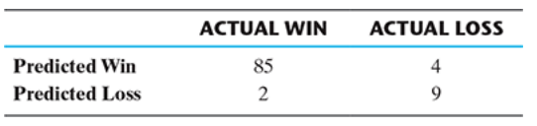


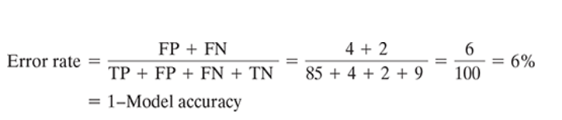
In the given confusion matrix, total count of TPs = 85, count of FPs = 4, count of FNs = 2 and count of TNs = 9.
TP
FP
FN
TN
The percentage of misclassifications is indicated using error rate which is measured as

Slide 48
Accuracy:
It’s the ratio of the correctly labeled subjects to the whole pool of subjects.
How many students did we correctly label out of all the students?
Accuracy = (TP+TN)/(TP+FP+FN+TN) numerator: all correctly labeled subject (All trues) denominator: all subjects

Slide 49

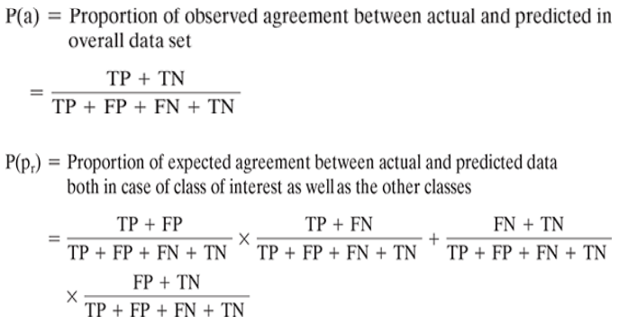
Kappa or Cohen's Kappa value of a model indicates the adjusted the model accuracy.
The kappa coefficient measures the agreement between classification and truth values.
The kappa statistic is used to control only those instances that may have been correctly classified by chance. Kappa = (total accuracy – random accuracy) / (1- random accuracy).

Slide 50
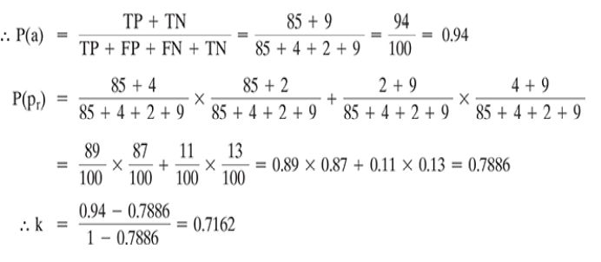
Kappa value can be 1 at the maximum, which represents perfect agreement between model’s prediction and actual values.
a kappa of less than 0.4 is considered poor
Kappa values of 0.4 to 0.75 are considered moderate to good and a kappa of >0.75 represents excellent agreement.
0 represents no agreement

Slide 51
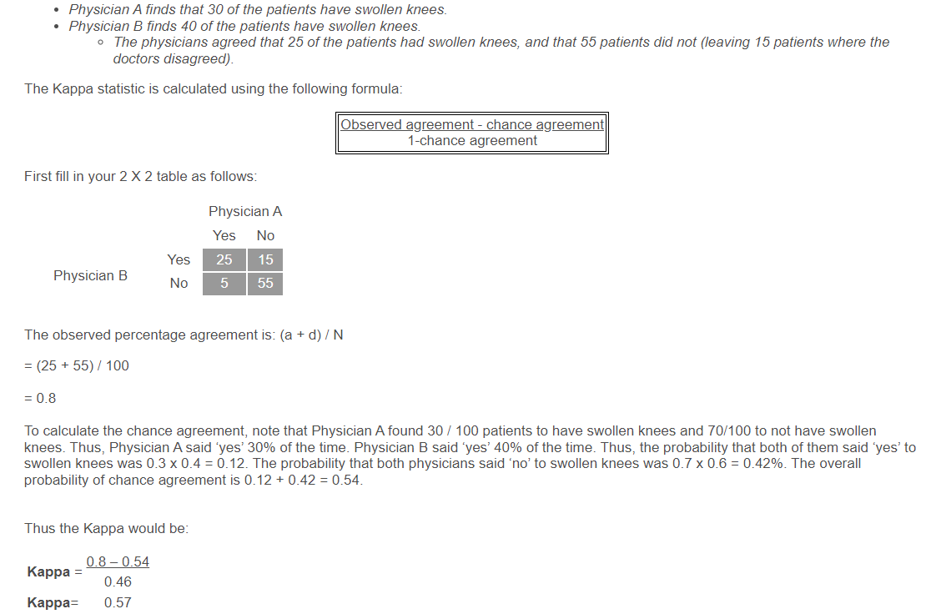

Slide 52
Misclassification happens more in problems from medical domains like disease prediction problem.
For example, if a tumor is malignant but wrongly classified as benign by the classifier - misclassification is fatal.
In these problems there are some measures of model performance which are more important than accuracy.
Two such critical measurements are sensitivity and specificity of the model

Slide 53
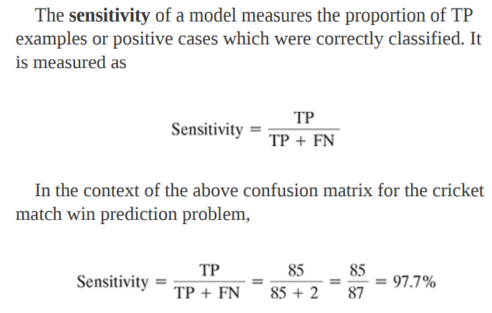
Sensitivity
classifying the 1’s correctly is more important than classifying the 0’s.
Another example:
The malignancy prediction of tumours, class of interest is ‘malignant’.
Sensitivity measure gives the proportion of tumours which are actually malignant and have been predicted as malignant.
A high value of sensitivity is more desirable than a high value of accuracy.

Slide 54

Specificity is also another good measure to indicate a good balance of a model being excessively conservative or excessively aggressive.
Specificity of a model measures the proportion of negative examples which have been correctly classified.
In the context, of malignancy prediction of tumours, specificity gives the proportion of benign tumours which have been correctly classified.
In context of the above confusion matrix for the cricket match win prediction problem
A higher value of specificity will indicate a better model performance.
It’s understandable that a conservative approach to reduce False Negatives might actually push up the number of FPs.
Reason: model, in order to reduce FNs, is going to classify more tumours as malignant.

Slide 55
Specificity
Specificity is the correctly -ve labeled by the program to all who are healthy in reality.
Of all the people who are healthy, how many of those did we correctly predict? Specificity = TN/(TN+FP) numerator: -ve labeled healthy people. denominator: all people who are healthy in reality (whether +ve or -ve labeled)

Slide 56

Two other performance measures of a supervised learning model similar to sensitivity and specificity.
Precision
recall
Precision indicates the reliability of a model in predicting a class of interest.
When the model is related to win / loss prediction of cricket, precision indicates how often it predicts the win correctly.
In context of the above confusion matrix for the cricket match win prediction problem
model with higher precision is perceived to be more reliable

Slide 57
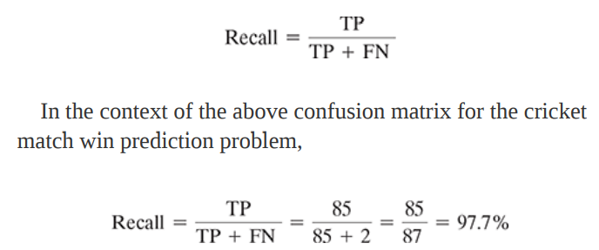
Recall indicates the proportion of correct prediction of positives to the total number of positives.
In case of win/loss prediction of cricket, recall resembles what proportion of the total wins were predicted correctly.

Slide 58
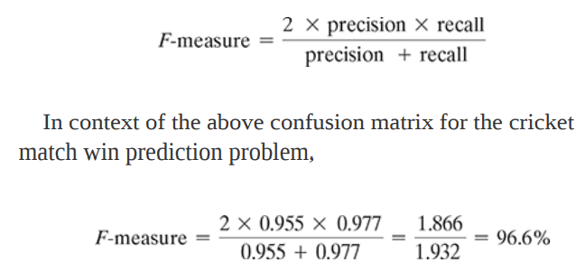
F-measure/F1 score/F Score:
F-measure is another measure of model performance which combines the precision and recall.
It takes the harmonic mean of precision and recall as calculated as
H = 2/ (1/a + 1/b) or H = 2ab/(a+b)
F1 Score = 2*(Recall * Precision) / (Recall + Precision)
It is calculated by dividing the number of observations by the reciprocal of each number in the series
F1 Score is best if there is some sort of balance between precision (p) & recall (r) in the system. Oppositely F1 Score isn’t so high if one measure is improved at the expense of the other.

Slide 59
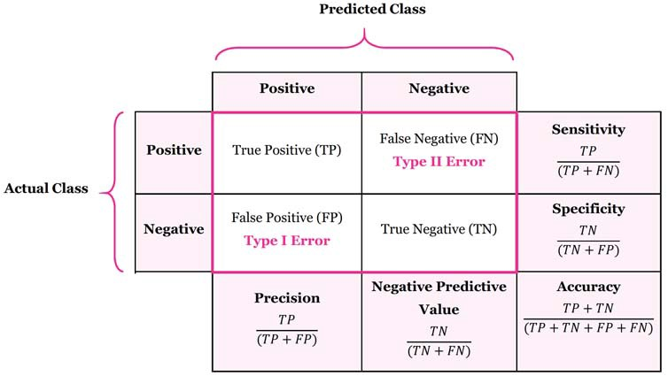

Slide 60
Precision:
Precision is the ratio of the correctly +ve labeled by our program to all +ve labeled.
How many of those who we labeled as diabetic are actually diabetic?
Precision = TP/(TP+FP) numerator: +ve labeled diabetic people. denominator: all +ve labeled by our program (whether they’re diabetic or not in reality).
Recall (aka Sensitivity)
Recall is the ratio of the correctly +ve labeled by our program to all who are diabetic in reality
Of all the people who are diabetic, how many of those we correctly predict?
Recall = TP/(TP+FN)
numerator: +ve labeled diabetic people. denominator: all people who are diabetic (whether detected by our program or not)

Slide 61
Receiver operating characteristic (ROC) curves
visualization is an easier and more effective way to understand the model performance.
The Receiver Operating Characteristic (ROC) curve is an evaluation metric for binary classification problems.
comparing the efficiency of two models.
is a graph showing the performance of a classification model at all classification thresholds.
It is a probability curve that plots the TPR against FPR at various threshold values and essentially separates the 'signal' from the 'noise'.
Receiver Operating Characteristic (ROC) curve helps in visualizing the performance of a classification model.

Slide 62
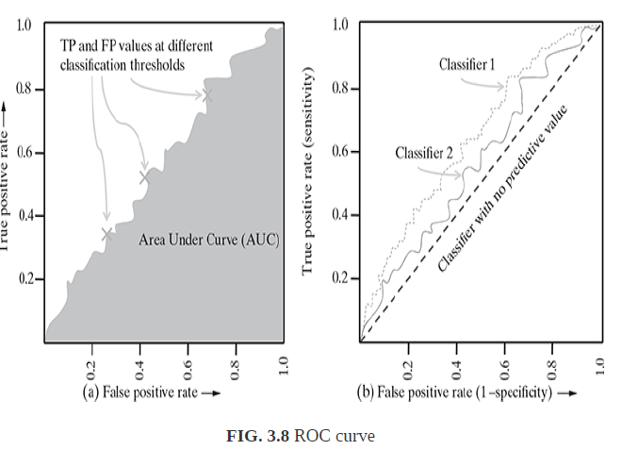

Slide 63
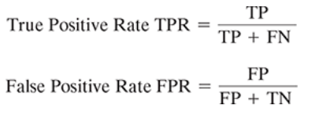
true positives are those cases where the model has correctly classified data instances as the class of interest.
Example: the model has correctly classified the tumours as malignant, in case of a tumour malignancy prediction problem
FPs are those cases where the model incorrectly classified data instances as the class of interest.
the model has incorrectly classified the tumours as malignant, i.e. tumours which are actually benign have been classified as malignant.
Recall /Sensitivity
1-specificity
Specificity =TN/TN+FP

Slide 64
ROC is a probability curve and AUC( Area Under the Curve) represents the degree or measure of separability.
It tells how much the model is capable of distinguishing between classes.
It is also written as AUROC (Area Under the Receiver Operating Characteristics)
An excellent model has AUC near to the 1 which means it has a good measure of separability.(predicting 0 classes as 0 and 1 classes as 1.)
A poor model has an AUC near 0 which means it has the worst measure of separability.(means it is reciprocating the result. It is predicting 0s as 1s and 1s as 0s. )
And when AUC is 0.5, it means the model has no class separation capacity.

Slide 65
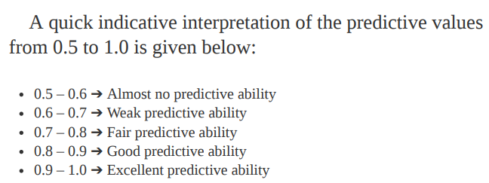

Slide 66
https://towardsdatascience.com/accuracy-recall-precision-f-score-specificity-which-to-optimize-on-867d3f11124
https://www.analyticsvidhya.com/blog/2020/06/auc-roc-curve-machine-learning/#:~:text=The%20Receiver%20Operator%20Characteristic%20(ROC,'%20from%20the%20'noise'. (roc-auc curve code)

Slide 67
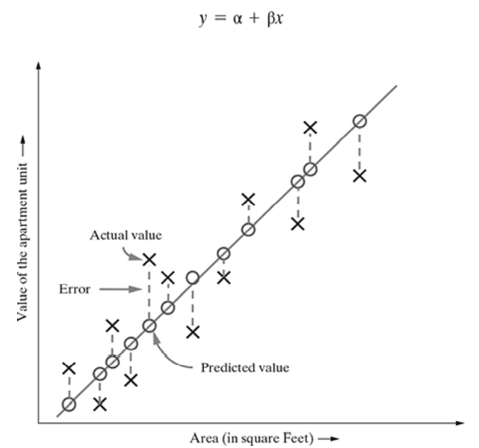
Supervised learning – regression
It ensures that the difference between predicted and actual values is low can be considered as a good model.
Residuals in statistics or machine learning are the difference/distance between an observed data value and a fitted or predicted data value. They are also known as errors.
residual value is less => well fitted regression model

Slide 68


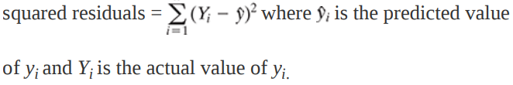
R-squared
R-squared is a good statistical measure to evaluate the model fitness.
It is also known as the coefficient of determination, or for multiple regression, the coefficient of multiple determination.
The R-squared value lies between 0 to 1 (0%–100%) with a larger value (close to 1) representing a better fit.
Sum of Squares Total (SST) = squared differences of each observation from
overall mean. where y̅ is the mean
Sum of Squared Errors (SSE) (of prediction) = sum of the
̅

Slide 69
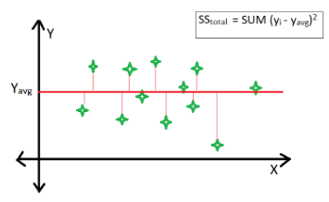
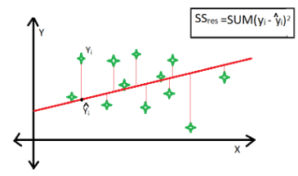
R-square is a comparison of the residual sum of squares (SS_{res}) or SSE with the total sum of squares(SS_{tot}) or SST.
The total sum of squares is calculated by summation of squares of perpendicular distance between data points and the average line.
The residual sum of squares is calculated by the summation of squares of perpendicular distance between data points and the best-fitted line.

Slide 70
Unsupervised learning - clustering
grouping unlabelled data is called Clustering
Clustering analysis uses similarity metrics to group data points that are close to each other and separate the ones which are farther apart. It is a widely used technique for market segmentation, pattern recognition, and image processing.
The two inherent challenges which lie in the process of clustering:
It is generally not known how many clusters can be formulated from a particular data set. It is completely open-ended in most cases and provided as a user input to a clustering algorithm.
Even if the number of clusters is given, the same number of clusters can be formed with different groups of data instances.

Slide 71
popular approaches for cluster quality evaluation:
Internal evaluation:
measure cluster quality based on
homogeneity of data belonging to the same cluster
heterogeneity of data belonging to different clusters.
The homogeneity/heterogeneity is decided by some similarity measure
example, silhouette coefficient, which is one of the most popular internal evaluation methods, uses distance (Euclidean or Manhattan distances most commonly used) between data elements as a similarity measure.
Internal Evaluation: Internal evaluation is based on the data that is clustered, which includes computing the inter- and intra-cluster distances.
The best score is assigned to a model if there is a high similarity within the inter-cluster points and a low similarity between intra-cluster points.

Slide 72
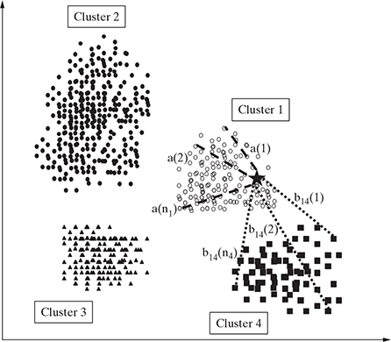

Silhouette score
The below formula tells us how to calculate the silhouette score for one data point.
The overall silhouette score is calculated by taking the mean.
b(i) represents the average distance of point i to all the points in the nearest cluster.
a(i) represents the average distance of point i to all the other points in its own cluster.
The silhouette score varies between +1 and -1, +1 being the best score and -1 being the worst.
0 indicates an overlapping cluster
negative values indicate that the point is assigned to the wrong cluster.

Slide 73
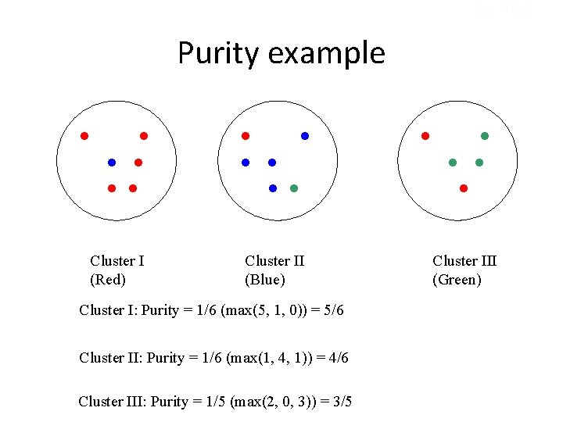

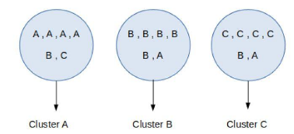
External evaluation:
External evaluation is based on data not used for clustering, which could include external benchmarks.(based on this others can be measured)
purity is one of the most popular measures of cluster algorithms :
The ratio between the most common class in the cluster and the size of the cluster
Assign a label to each cluster based on the most frequent class in it.
Then the purity becomes the number of correctly matched class and cluster labels divided by the number of total data points.
Where, n’ data instances and ‘c’ known class labels which
generates ‘k’ clusters, purity is measured as

Slide 74
IMPROVING PERFORMANCE OF A MODEL
Model selection is done on several aspects:
1. Type of learning the task in hand, i.e. supervised or unsupervised
2. Type of the data, i.e. categorical or numeric
3. Sometimes on the problem domain
4. Above all, experience in working with different models to solve problems of diverse domains

Slide 75
IMPROVING PERFORMANCE OF A MODEL
First Approach:
Model parameter tuning is the process of adjusting the model fitting options.
hyperparameter optimization or tuning is the problem of choosing a set of optimal hyperparameters for a learning algorithm.
Model tuning is also known as hyperparameter optimization.
using different values of ‘k’ or the number of nearest neighbours to be considered, the model can be tuned

Slide 76
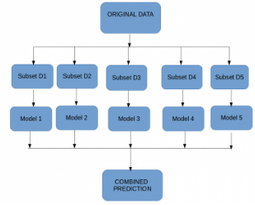
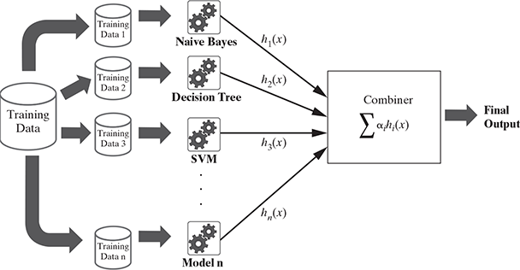
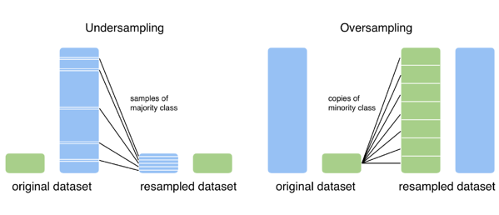
Another approach:
To increase the performance of one model, several models may be combined together with diverse strengths is known as ensemble.
most popular ensemble models is bootstrap aggregating or bagging uses bootstrap sampling method to generate multiple training data sets.
Boosting(weaker learning models are trained on resampled data), Adaptive boosting or AdaBoost, Random forest (ensemble of decision trees)

Slide 77
Basics of Feature Engineering
Another very important aspect of machine learning, that is feature engineering.
FE is not a core of ML ,it is an allied task need to perform to make learning more effective.
is a part of the preparatory activities
It is responsible for taking raw input data and converting that to well-aligned features which are ready to be used by the machine learning models.
Three key components –
feature construction, feature selection, and feature transformation

Slide 78
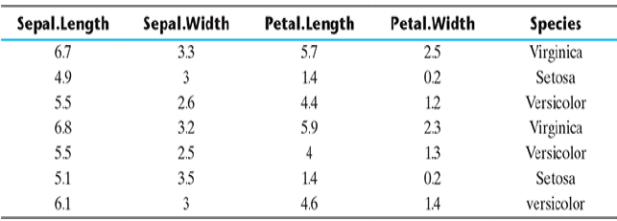
Feature
A feature is an attribute of a data set that is used in a machine learning process.
selection of the subset of features which are meaningful for machine learning is a sub-area of feature engineering.
The features in a data set are also called its dimensions. So a data set having ‘n’ features is called an n-dimensional data set.
predictor variables
Class variable - Species
5 dimensional dataset

Slide 79
Feature engineering
Feature engineering refers to the process of translating a data set into features such that these features are able to represent the data set more effectively and result in a better learning performance.
It has two major elements:
1. feature transformation
2. feature subset selection

Slide 80
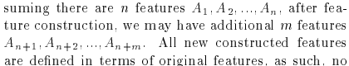
Feature transformation transforms the data – structured or unstructured, into a new set of features.
Two variants of feature transformation:
1. feature construction
2. feature extraction
Both are sometimes known as feature discovery.
Feature construction process : through which a set of new features is created .
Hence, if there are ‘n’ features or dimensions in a data set, after feature construction ‘m’ more features or dimensions may get added.
So at the end, the data set will become ‘n + m’ dimensional.
Feature extraction is the process of extracting or creating a new set of features from the original set of features using some functional mapping.

Slide 81
Feature subset selection
Unlike feature transformation, in case of feature subset selection (or simply feature selection) no new feature is generated.
The objective of feature selection is to derive a subset of features from the full feature set which is most meaningful in the context of a specific machine learning problem.
So, essentially the job of feature selection is to derive a subset
where m < n, such that F is most meaningful and gets the best result for a machine learning problem.

Slide 82
FEATURE TRANSFORMATION
two distinct goals of feature transformation
Achieving best reconstruction of the original features in the data set
Achieving highest efficiency in the learning task
Feature construction :
Feature construction involves transforming a given set of input features to generate a new set of more powerful features.
The data set has three features –
apartment length
apartment breadth
price of the apartment
Instead of having length and breadth, area of the apartment is more convenient to predict the price, which is not an existing feature
Transform the three dimensional data set to a four-dimensional data set, with the newly ‘discovered’ feature apartment area being added to the original data set.

Slide 83
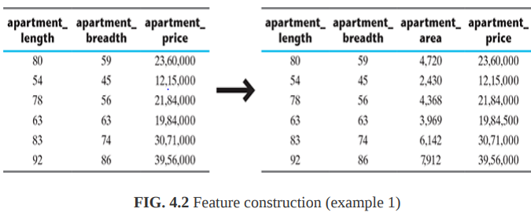
certain situations where feature construction is an essential activity :
when features have categorical value and machine learning needs numeric value inputs
when features having numeric (continuous) values and need to be converted to ordinal values
when text-specific feature construction needs to be done.

Slide 84
Feature construction :
Encoding categorical (nominal) variables:
the data set has features age, city of origin, parents athlete (i.e. indicate whether any one of the parents was an athlete) and Chance of Win.
classification algorithm (like kNN) or a regression algorithm, requires numerical figures to learn from.
City of origin, Parents athlete, and Chance of win, which are categorical in nature.
feature construction can be used to create new dummy features which are usable by machine learning algorithms.
Parents athlete’ and ‘Chance of win’ in the original data set can have two values only.
So creating two features from them is a kind of duplication, since the value of one feature can be decided from the value of the other.
To avoid this duplication, we can just leave one feature and eliminate the other

Slide 85
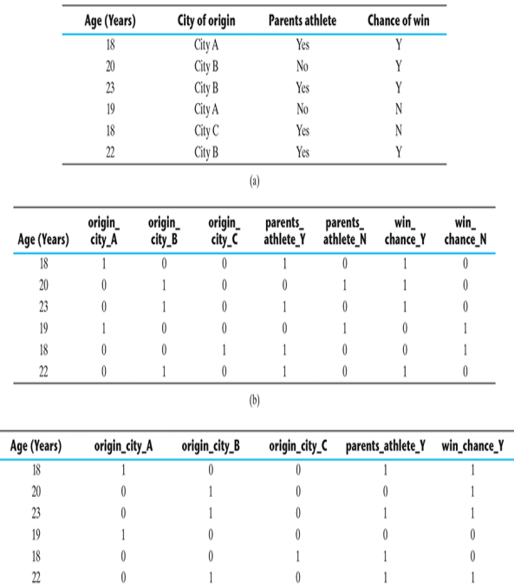

Slide 86
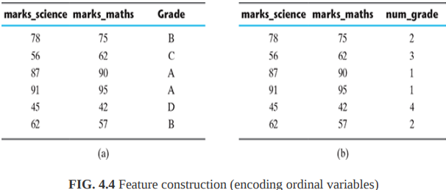
Feature construction :
Encoding categorical (ordinal) variables:
there are three variable – science marks, maths marks and grade.
the grade is an ordinal variable with values A, B, C, and D.
To transform this variable to a numeric variable, we can create a feature num_grade mapping a numeric value against each ordinal value.
grades A, B, C, and D is mapped to values 1, 2, 3, and 4

Slide 87
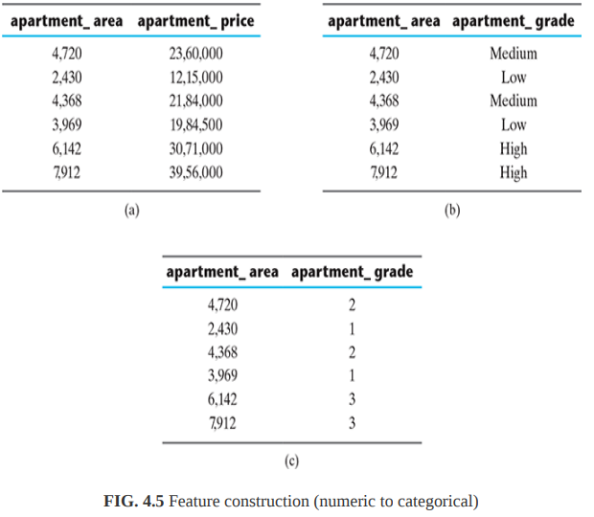
Feature construction :
Transforming numeric (continuous) features to categorical features:
we may want to treat the real estate price prediction problem, which is a regression problem, as a real estate price category prediction, which is a classification problem.
the numerical data into multiple categories based on the data range.

Slide 88
Feature construction :
Text-specific feature construction:
text plays a major role in the flow of information in social medias like, facebok, twitter, insta etc., . Hence, text mining is an important area of research
All machine learning models need numerical data as input.
So the text data in the data sets need to be transformed into numerical features.
Process of converting Text data, or corpus is converted to a numerical representation –vectorization.
In this process, word occurrences in all documents belonging to the corpus are consolidated in the form of bag-of-words or bog of n-grams.
There are three major steps(startegies) that are followed:
1. tokenize
2. count
3. normalize

Slide 89
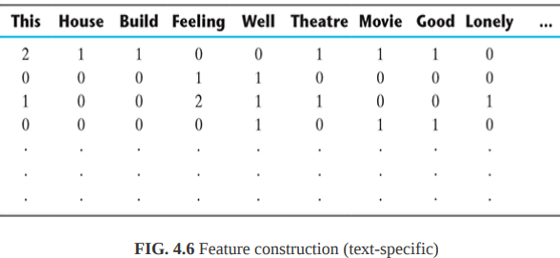
To tokenize a corpus, the blank spaces and punctuations are used as delimiters to separate out the words, or tokens.
Then the number of occurrences of each token is counted, for each document.
Lastly, tokens are weighted with reducing importance when they occur in the majority of the documents (a normalized encoding where each word is weighted by the total number of words in the document)
A matrix -each token representing a column and a specific document of the corpus representing each row.
Each cell contains the count of occurrence of the token in a specific document.
This matrix is known as a document-term matrix (also known as a term document matrix)

Slide 90
Frequency Vectors:
Frequency encoding should be normalized, but different types of frequency encoding can benefit probabilistic methods like Bayesian models.
One hot Encoding:
a boolean vector encoding method that marks a particular vector index with a value of true (1) if the token exists in the document and false (0) if it does not.
https://www.oreilly.com/library/view/applied-text-analysis/9781491963036/ch04.html - text vectorization
https://www.oreilly.com/library/view/applied-text-analysis/9781491963036/ch04.html

Slide 91
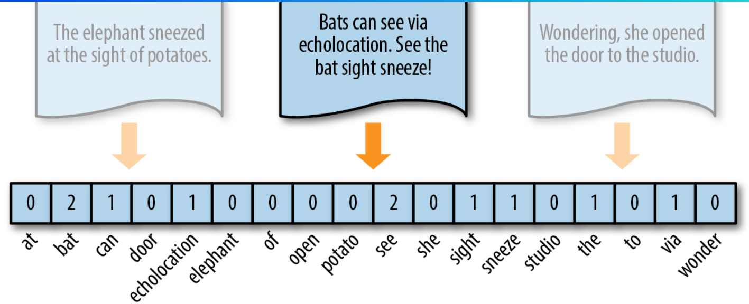
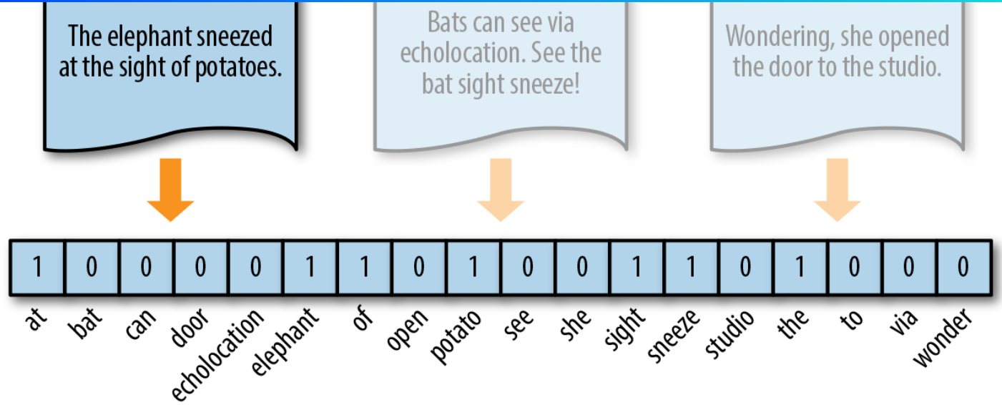
Frequency Vector
One-Hot Encoding

Slide 92
Step #1 : We will first preprocess the data, in order to:
Convert text to lower case.
Remove all non-word characters.
Remove all punctuations.
import nltk
import re
import numpy as np
# execute the text here as :
# text = """ # place text here """
dataset = nltk.sent_tokenize(text)
for i in range(len(dataset)):
dataset[i] = dataset[i].lower()
dataset[i] = re.sub(r'\W', ' ', dataset[i])
dataset[i] = re.sub(r'\s+', ' ', dataset[i])

Slide 93
Step #2 : Obtaining most frequent words in our text.
We will apply the following steps to generate our model.
We declare a dictionary to hold our bag of words.
Next we tokenize each sentence to words.
Now for each word in sentence, we check if the word exists in our dictionary.
If it does, then we increment its count by 1. If it doesn’t, we add it to our dictionary and set its count as 1.
# Creating the Bag of Words model
word2count = {}
for data in dataset:
words = nltk.word_tokenize(data)
for word in words:
if word not in word2count.keys():
word2count[word] = 1
else:
word2count[word] += 1
In our model, we have a total of 118 words. However when processing large texts, the number of words could reach millions. We do not need to use all those words. Hence, we select a particular number of most frequently used words. To implement this we use:
import heapq
freq_words = heapq.nlargest(100, word2count, key=word2count.get)
where 100 denotes the number of words we want. If our text is large, we feed in a larger number.

Slide 94
Step #3 : Building the Bag of Words model In this step we construct a vector, which would tell us whether a word in each sentence is a frequent word or not.
If a word in a sentence is a frequent word, we set it as 1, else we set it as 0.
This can be implemented with the help of following code:
X = []
for data in dataset:
vector = []
for word in freq_words:
if word in nltk.word_tokenize(data):
vector.append(1)
else:
vector.append(0)
X.append(vector)
X = np.asarray(X)

Slide 95




Feature extraction
New features are created from a combination of original features.
Some of the commonly used operators for combining the original features include
1. For Boolean features: Conjunctions, Disjunctions, Negation, etc.
2. For nominal features: Cartesian product, M of N, etc.
3. For numerical features: Min, Max, Addition, Subtraction, Multiplication, Division, Average, Equivalence, Inequality, etc.
we have a data set with a feature set
After feature extraction using a mapping function
will have a set of features

Slide 96
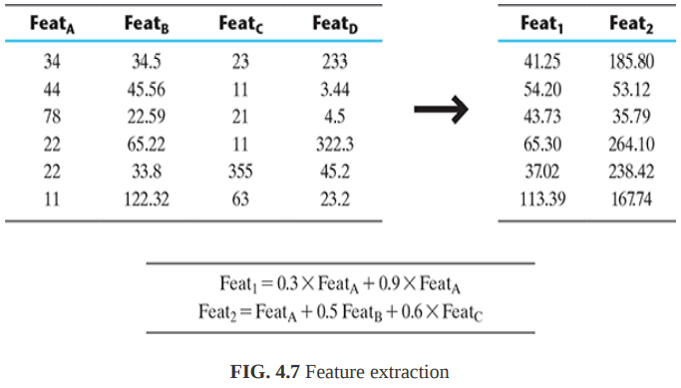

Slide 97
Feature extraction
most popular feature extraction algorithms used in machine learning. (is an unsupervised learning algorithm)
Principal Component Analysis(PCA):
is a dimensionality-reduction method that is often used to reduce the dimensionality of large data sets, by transforming a large set of variables into a smaller one that still contains most of the information in the large set.
In simple Terms:
reduce the number of variables of a data set, while preserving as much information as possible.
a key to the success of machine learning lies in the fact that the features are less in number as well as the similarity between each other is very less.
https://builtin.com/data-science/step-step-explanation-principal-component-analysis

Slide 98
In PCA, a new set of features are extracted from the original features which are quite dissimilar in nature.
So an ndimensional feature space gets transformed to an mdimensional feature space, where the dimensions are orthogonal to each other, i.e. completely independent of each other.
To understand the concept of orthogonality, vector space concept in linear algebra
a vector is a quantity having both magnitude and direction and hence can determine the position of a point relative to another point in the Euclidean space (i.e. a two or three or ‘n’ dimensional space).
The magnitude is the length of the vector while the direction tells us which way the vector points.

Slide 99

A vector space is a set of vectors.
Vector spaces have a property that they can be represented as a linear combination of a smaller set of vectors, called basis vectors.
So, any vector ‘v’ in a vector space can be represented as
a represents ‘n’ scalars and u represents the basis vectors.
Basis vectors are orthogonal to each other.
Two orthogonal vectors are completely unrelated or independent of each other.

Slide 100
The objective of PCA is to make the transformation in such a way that
1. The new features are distinct, i.e. the covariance between the new features, i.e. the principal components is 0.
2. The principal components are generated in order of the variability in the data that it captures. Hence, the first principal component should capture the maximum variability, the second principal component should capture the next highest variability etc.
3. The sum of variance of the new features or the principal components should be equal to the sum of variance of the original features.

Slide 101
some properties of these principal components are given below:
The principal component must be the linear combination of the original features.
These components are orthogonal, i.e., the correlation between a pair of variables is zero.
The importance of each component decreases when going to 1 to n, it means the 1 PC has the most importance, and n PC will have the least importance.

Slide 102
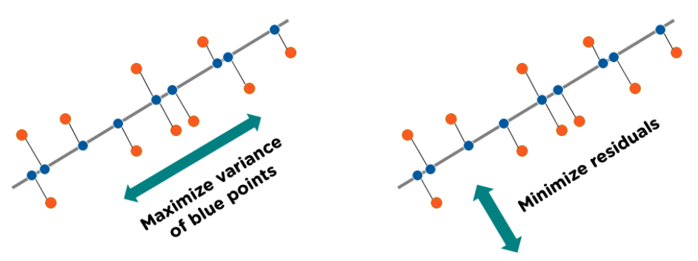
PCA works based on a process called eigenvalue decomposition of a covariance matrix of a data set. Below are the steps to be followed:
1. First, calculate the covariance matrix of a data set.
2. Then, calculate the eigenvalues of the covariance matrix.
3. The eigenvector having highest eigenvalue represents the direction in which there is the highest variance. So this will help in identifying the first principal component.
4. The eigenvector having the next highest eigenvalue represents the direction in which data has the highest remaining variance and also orthogonal to the first direction. So this helps in identifying the second principal component.
5. Like this, identify the top ‘k’ eigenvectors having top ‘k’ eigenvalues so as to get the ‘k’ principal components.

Slide 103


How does Principal Component Analysis Work?
Normalize the data:
Standardize the data before performing PCA. This will ensure that each feature has a mean = 0 and variance = 1. name the matrix as Z.
Build the covariance matrix:
Construct a square matrix to express the correlation between two or more features in a multidimensional dataset.
To calculate the covariance of Z, we will take the matrix Z, and will transpose it. After transpose, we will multiply it by Z. The output matrix will be the Covariance matrix of Z.
Find the Eigenvectors and Eigenvalues:
Calculate the eigenvectors/unit vectors and eigenvalues. Eigenvalues are scalars by which we multiply the eigenvector of the covariance matrix.
Eigenvectors or the covariance matrix are the directions of the axes with high information. And the coefficients of these eigenvectors are defined as the eigenvalues.
Sort the eigenvectors in highest to lowest order and select the number of principal components.

Slide 104
Some common terms used in PCA algorithm:
Dimensionality: It is the number of features or variables present in the given dataset. More easily, it is the number of columns present in the dataset.
Correlation: It signifies that how strongly two variables are related to each other. Such as if one changes, the other variable also gets changed. The correlation value ranges from -1 to +1. Here, -1 occurs if variables are inversely proportional to each other, and +1 indicates that variables are directly proportional to each other.
Orthogonal: It defines that variables are not correlated to each other, and hence the correlation between the pair of variables is zero.
Eigenvectors: If there is a square matrix M, and a non-zero vector v is given. Then v will be eigenvector if Av is the scalar multiple of v.
Covariance Matrix: A matrix containing the covariance between the pair of variables is called the Covariance Matrix.

Slide 105
https://www.geeksforgeeks.org/ml-principal-component-analysispca/
https://www.simplilearn.com/tutorials/machine-learning-tutorial/principal-component-analysis#:~:text=The%20Principal%20Component%20Analysis%20is,plotting%20in%202D%20and%203D.
https://www.javatpoint.com/principal-component-analysis

